Slide 1
Defect Management
Defect management is a crucial and structured process within the software development life cycle (SDLC) that involves the systematic identification, documentation, tracking defects, categorization, prioritization, resolution, and closure of found during software testing. The primary goal is not only to detect defects early in the development phase but also to ensure that they are resolved quickly and do not reappear in the future releases. This process helps improve the overall quality, performance, and reliability of the software product. A good defect management system also facilitates better communication between testers, developers, and project managers by using tools like JIRA or Bugzilla to record and monitor the life cycle of each defect. It includes various phases such as defect logging, triaging, assignment, fixing, verification, and closure.

Slide 2
defects
defects in software testing are variations between the end’s requirements or business requirements.
Testers who validate a code snippet see deviations or differences between the expected and existing outcomes. These variations are known as defects. They typically identify defects during test execution.

Slide 3
bug
If testers find any mismatch in the application/system in testing phase then they call it as Bug.
A bug refers to an issue in the software that causes it to behave unexpectedly. Bugs can be caused by a variety of factors, including incorrect logic, poor design, or even a mistake made during the coding process.
A software bug is a mistake or flaw in the code that causes unexpected software behavior. Bugs are typically identified during testing and can range from minor glitches to critical issues impacting functionality.

Slide 4
Error
A software error refers to a mistake made by the developer during the software system development life cycle. This can happen at any stage of development, such as during coding, design, or testing. Errors typically lead to bugs or defects, which are later discovered during testing.
Errors may arise due to human errors, such as incorrect logic implementation or misinterpretation of requirements. Using automation tools for software testing can help in catching these errors early in the process, ensuring more robust software products.

Slide 5
Failure
A failure occurs when the software does not perform as expected and delivers incorrect results or it completely stops working. A failure can be the result of a fault in the system or an environmental issue such as a network disruption.
In the software development life cycle phases, failures are typically discovered during functional testing or integration/system testing and are usually a red flag indicating a serious problem.

Slide 6
Defect Age
Defect age is used to denote time difference, in terms of defects being detected and defects being resolved. A defect is measured on the basis of the turn around time, that is, actual time taken to fix the defect divided by the planned time taken to fix the defect. When a defect occurs, the development team tries to analyse it's impact and decides on a target fix date , by when it shall be resolved.

Slide 7
Hotfix
A hotfix in software testing is a quick update made to a software program to fix a specific issue or bug. It’s usually created and released quickly to ensure the software continues to work correctly and to minimize any inconvenience to users. Hotfixes are essential for maintaining the smooth operation of software, especially when critical issues arise that need immediate attention.
Hotfixes are used by software developers and IT professionals. They apply hotfixes to quickly correct critical issues in software that can’t wait for the next regular updateHotfixes help ensure that the software continues to run smoothly and securely for all users.

Slide 8
Defect leakage
Defect leakage refers to bugs or issues that are not detected during the testing phase and are discovered only after the software is released into production. These are often found by customers, end-users, or support teams.
Example: Imagine a banking app with a “Transfer Funds” button that works correctly during testing. However, in the production environment, it fails to process international transfer transactions. This indicates a defect that leaked through the QA process.

Slide 9
When to stop testing
Budget or/and resources were allocated to some other high priority project
The project was canceled (from the client’s side or the company’s side)
The allocated budget is over and no more budget is being allocated.
Deadlines that need to be met
No high priority and severity bugs found/expected
Completion of test case execution
Completion of functional and code coverage to a certain point
Completion of the acceptance criteria and exit criteria.

Slide 10
Bug Life Cycle
A Bug Life Cycle in Software Testing is the journey of the bug from the state of its ‘Identification’ to the state of its ‘Closure’. The entire process of finding and resolving a defect or bug constitutes a bug life cycle.

Slide 11
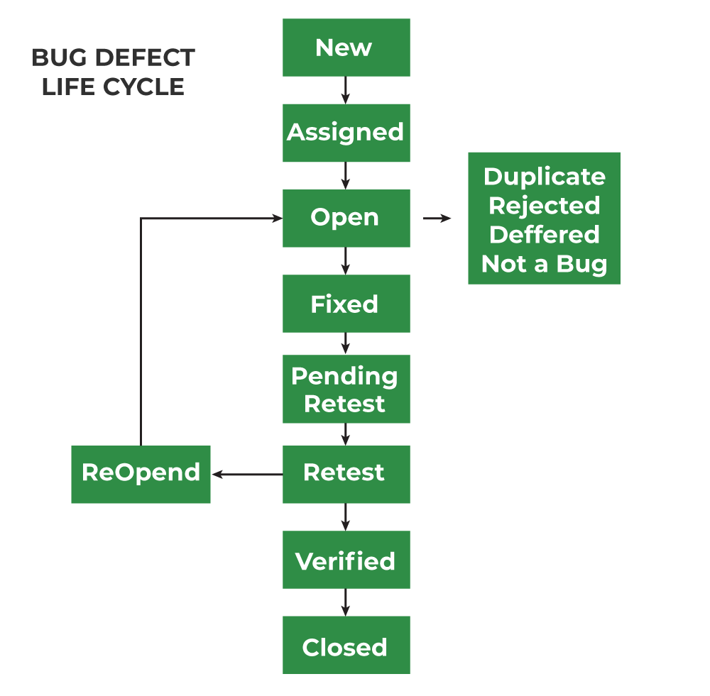

Slide 12
1. New: When any new defect is identified by the tester, it falls in the 'New’ state. It is the first state of the Bug Life Cycle. The tester provides a proper Defect document to the Development team so that the development team can refer to Defect Document and can fix the bug accordingly.
2. Assigned: Defects that are in the status of 'New' will be approved and that newly identified defect is assigned to the development team for working on the defect and to resolve that. When the defect is assigned to the developer team the status of the bug changes to the 'Assigned' state.
3. Open: In this 'Open' state the defect is being addressed by the developer team and the developer team works on the defect for fixing the bug. Based on some specific reason if the developer team feels that the defect is not appropriate then it is transferred to either the 'Rejected' or 'Deferred' state.
4. Fixed: After necessary changes of codes or after fixing identified bug developer team marks the state as 'Fixed'.
5. Pending Retest: During the fixing of the defect is completed, the developer team passes the new code to the testing team for retesting. And the code/application is pending for retesting on the Tester side so the status is assigned as 'Pending Retest'.

Slide 13
6. Retest: At this stage, the tester starts work of retesting the defect to check whether the defect is fixed by the developer or not, and the status is marked as 'Retesting'.
7. Reopen: After 'Retesting' if the tester team found that the bug continues like previously even after the developer team has fixed the bug, then the status of the bug is again changed to 'Reopened'. Once again bug goes to the 'Open' state and goes through the life cycle again. This means it goes for Re-fixing by the developer team.
8. Verified: The tester re-tests the bug after it got fixed by the developer team and if the tester does not find any kind of defect/bug then the bug is fixed and the status assigned is 'Verified'.
9. Closed: It is the final state of the Defect Cycle, after fixing the defect by the developer team when testing found that the bug has been resolved and it does not persist then they mark the defect as a 'Closed' state.

Slide 14
1. Rejected: If the developer team rejects a defect if they feel that defect is not considered a genuine defect, and then they mark the status as ‘Rejected’. The cause of rejection may be any of these three i.e Duplicate Defect, NOT a Defect, Non-Reproducible.
2. Deferred: All defects have a bad impact on developed software and also they have a level based on their impact on software. If the developer team feels that the defect that is identified is not a prime priority and it can get fixed in further updates or releases then the developer team can mark the status as 'Deferred'. This means from the current defect life cycle it will be terminated.
3. Duplicate: Sometimes it may happen that the defect is repeated twice or the defect is the same as any other defect then it is marked as a 'Duplicate' state and then the defect is 'Rejected'.
4. Not a Defect: If the defect has no impact or effect on other functions of the software then it is marked as 'NOT A DEFECT' state and 'Rejected'.

Slide 15
bug report
A bug report is a document that provides detailed information about a software defect or issue faced during software testing of the software.
The purpose of a software bug report is to communicate and document every software issue found during testing. The QA team spends considerable time finding the hidden bugs and also creates a report in a way that is beneficial to developers. By reporting bugs, developers can find and understand the issues quickly.
This way, bug reports serve as a crucial tool for identifying, tracking, and resolving software bugs, ensuring the quality and reliability of the software.

Slide 16
BUG REPORT TEMPLATE
Defect ID: Add a Defect ID using a naming convention followed by your team. The Defect ID will be generated automatically in case of defect management tool.
Reporter Name: Name of the one who found the defect (Usually tester’s name but sometimes it might be Developer, Business Analyst, Subject Matter Expert (SME), Customer)
Defect Reported Date: Date of the defect reported
Who Detected: Add the designation of the one who found the defect. E.g. QA, Developer, Business Analyst, SME, Customer
How Detected: Testing, Review, Walkthrough

Slide 17
Project Name: Add name of the project. (If it’s a product, add product name)
Release/Build Version: Add the build version details here
Defect/Enhancement: Add whether it is defect or improvement
Environment: Add Operation Systems details, Browser Details and any other related to the test environment.
(E.g. Windows 8/Chrome 48.0.2564.103)
Priority: Add the priority of the bug
(E.g. High/Medium/Low)
Severity: Add the severity of the bug
(E.g. Critical/High/Medium/Low)

Slide 18
Status: Add the status of the bug. If you just found and posting it then it will be New. The status of the bug will change.
(E.g. New/ Assigned/ Open/ Fixed/ Test/ Verified/ Closed/ Reopen/ Duplicate/ Deferred/ Rejected/ cannot be fixed/ Not Reproducible/ Need more information)
Description: Add a detailed description.
Steps to reproduce: Mention steps in detail. So that even the one who has no idea about the application also could reproduce the bug.

Slide 19
URL: Add the URL of the application (If available)
Expected Result: Mention the expected result here which is available in your test case document.
Actual Result: Mention the actual result here which is available in your test case document.
Defect Close Date: Add the defect close date only once you ensure that the defect is not reproducible.
e g: Bug Report

Slide 20
Bug severity
Severity is basically a parameter that denotes the impact of any defect and its implication on a software’s functionality. In other words, Severity defines the overall impact that any defect can have on a system.
For instance, consider if a web page or an application crashes after clicking on a remote link. In such a case, a user would rarely click on the remote link. Yet, the overall impact of an app crashing is very severe. Hence, the severity gets high, and yet the priority gets low.

Slide 21
Bug priority
In this, the defect with a higher priority first needs to get fixed. Priority basically defines the order in which one would resolve any given defect. The priority status defines if we should fix something or wait. The tester sets this priority status to the developer along with mentioning a time frame that can fix that defect. If they mention a higher priority, then the developer needs to fix it at the very earliest. Basically, the priority status comes into play according to the customer’s requirements.
For instance, let’s consider a case where one misspells the company name on a website’s home page. Thus, in this case, the Priority gets high while the Severity gets low for fixing it.

Slide 22
Bug tracking tools
Bug tracking tools help testers and developers to record, track, and fix bugs found in software. Two popular tools are JIRA and Redmine.
JIRA is a tool used by many companies to manage bugs, tasks, and projects.
Redmine is a free and open-source tool. It helps track bugs, manage projects, and assign tasks to team members.

